Slide 1
Image Classification
👦Elif 👨Nikesh 👨 Deepak

Slide 2
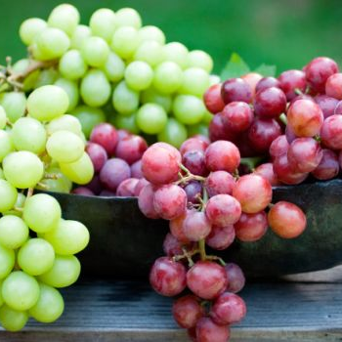
What is Image Classification?
Can you identify the object below?
Train a system to do the same
Given image of an object, we would like to train a system to correctly predict what the image represents.

Slide 3
Why Image Classification?
Facebook’s “Alternative text” accessibility feature.
Google’s image search
Autonomous Cars
Surveillance/Security

Slide 4
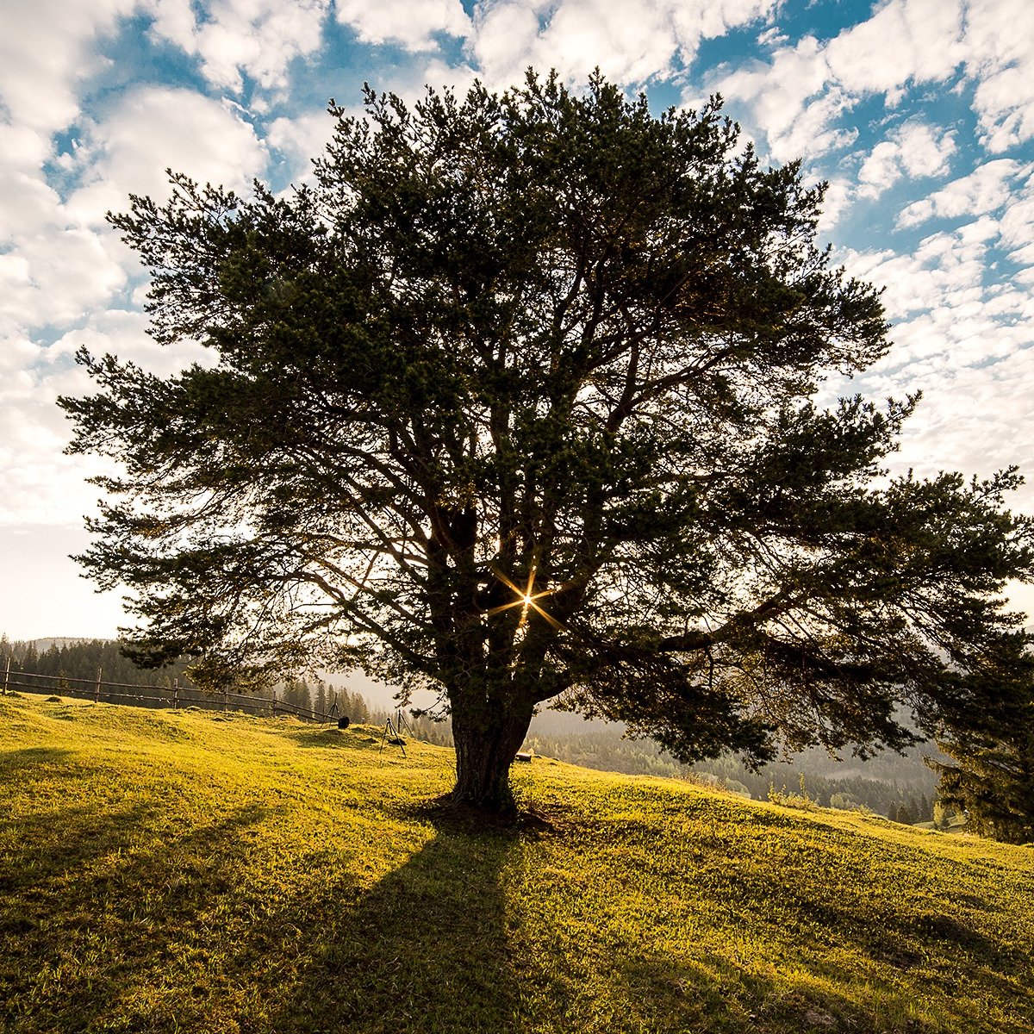
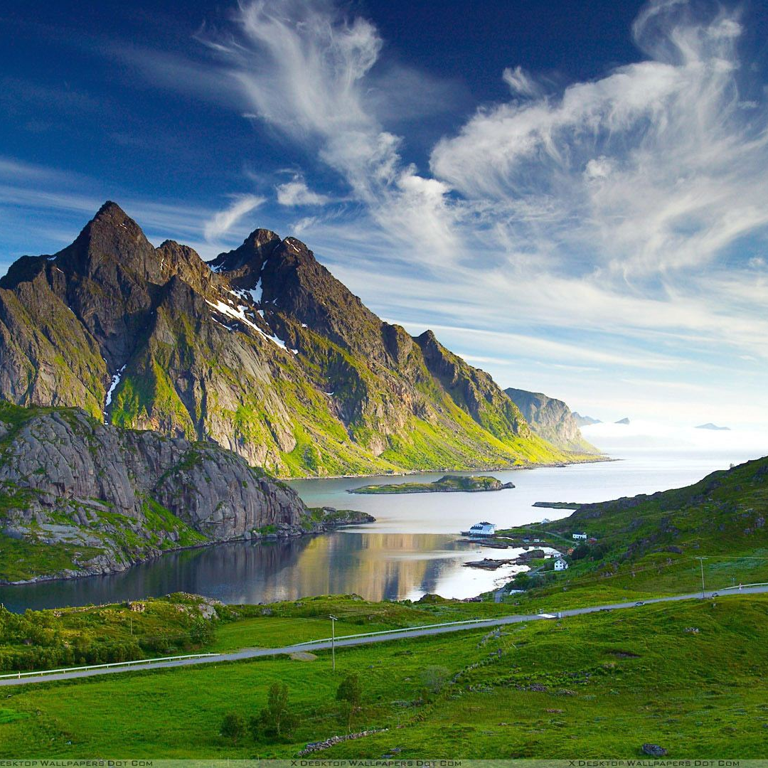
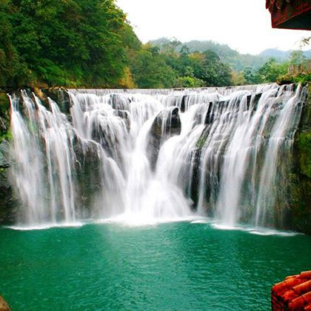
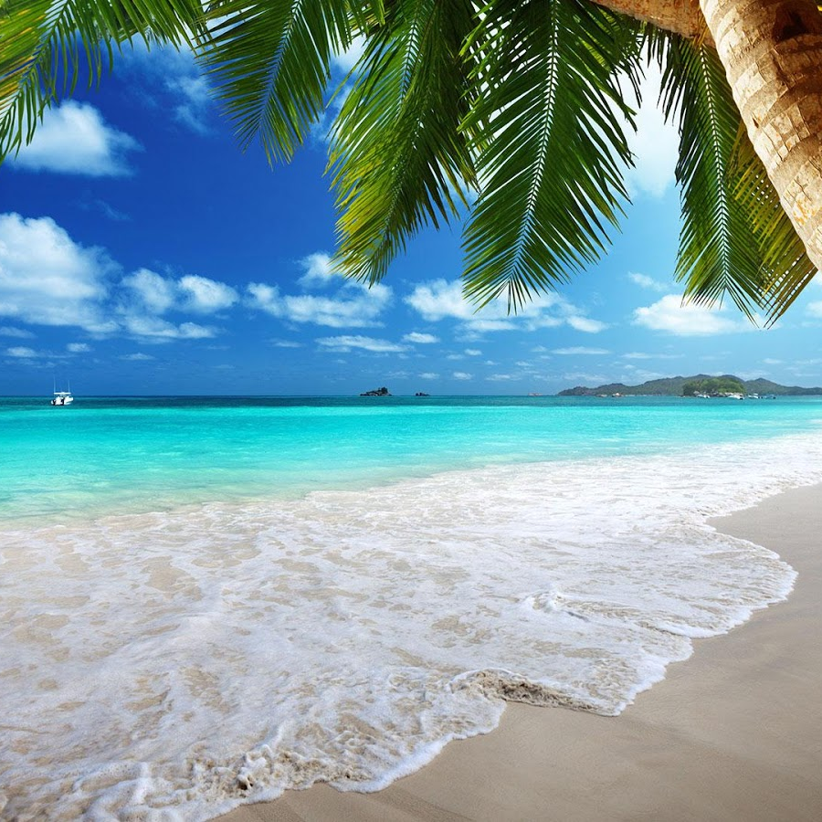
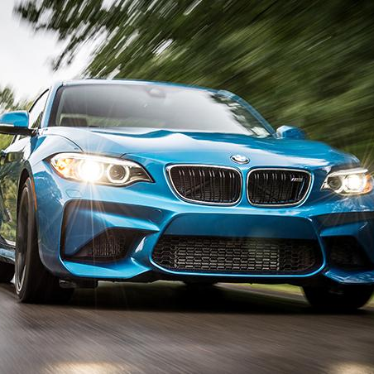
Categories

Slide 5
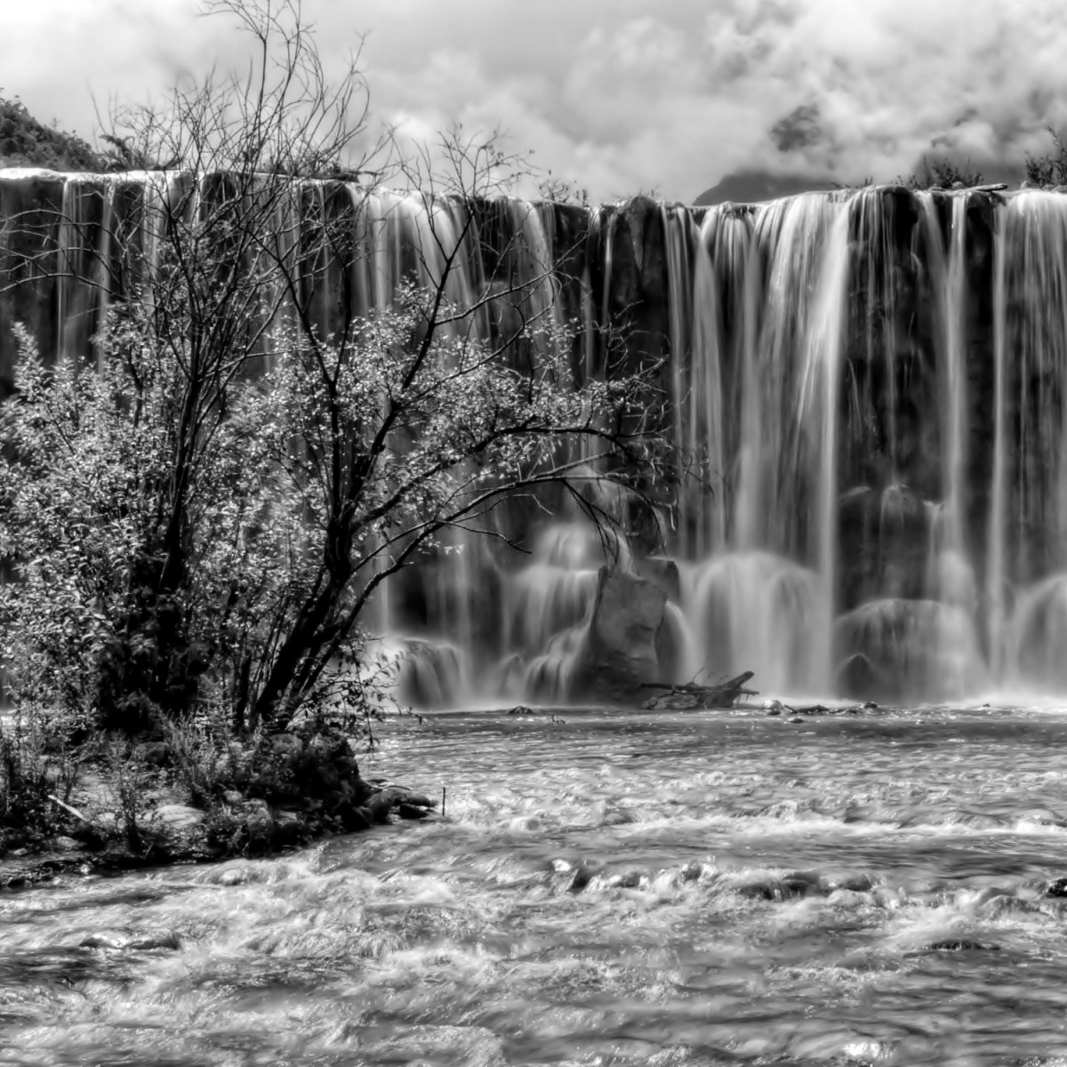
Image Pre-processing
gray_pixels <- function(Image) {
im <- load.image(Image)
gray <- grayscale(im)
resize.im <- resize(gray, w=200, h=200)
mat <- matrix(resize.im, nrow=1)
return(mat)
}

Slide 6
Data Frame
X1 | X2 | …………... | X40000 | CLASS
127 | 30 | 76.8 | 76.7 | Tree
234 | 125 | 76.9 | 45.8 | Car
45 | 34.8 | 35.6 | 124 | Mountain
…………… | ………….. | ……... | ………. | ………...
Reduced to:
200 X 40001
X1 | X2 | … | X150 | CLASS
45 | 6 | .. | 76.7 | Tree
67 | 125 | .. | 45.8 | Car
7 | 123 | .. | 124 | Mountain
… | ... | ... | … | ...
200 X 151

Slide 7
Our Process is Easy
Preprocessing
PCA
SVM

Slide 8
Algorithms
Principal Component Analysis
Support Vector Machine
K-Nearest Neighbor
Random Forest

Slide 9
Support Vector Machine
Use of Support Vector Machine with radial kernel.
Tuned the SVM using cross validation and the best values for the parameters cost and gamma were 1.265 and 0.001 respectively.

Slide 10
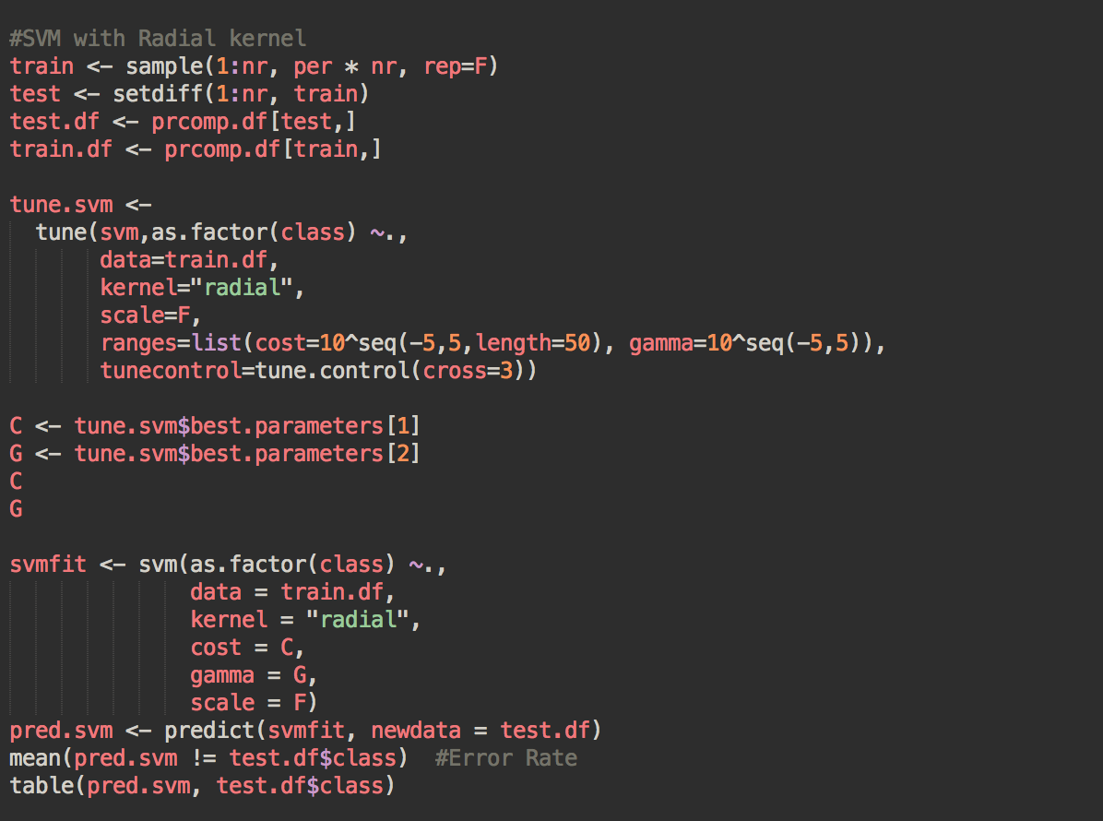
Code Snippet For SVM

Slide 11
Confusion Matrix for SVM
Error Rate: 12%
Prediction\Test | Beach | Car | Mountain | Tree | Waterfall
Beach | 11 | 0 | 1 | 0 | 1
Car | 0 | 7 | 0 | 1 | 0
Mountain | 0 | 0 | 7 | 1 | 0
Tree | 0 | 1 | 0 | 8 | 1
Waterfall | 0 | 0 | 0 | 0 | 10

Slide 12
Random Forest
Performed comparison of SVM with other algorithms such as Random Forest.
Random Forest is based on decision trees. This model built 500 random trees and the output was the mean prediction from each of those decision trees.

Slide 13
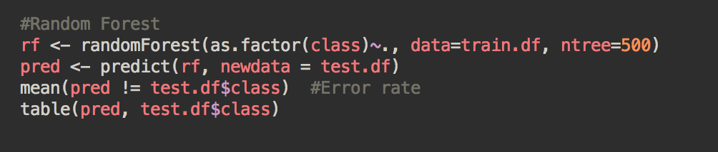
Code Snippet for Random Forest

Slide 14
k-Nearest Neighbor
An object is classified by a majority vote of its neighbors. It is one of the simplest ML algorithm based on the assumption that an object behaves in similar way to its closest neighbor.
In k-NN, k refers to the “k” neighbors being considered for the vote.

Slide 15
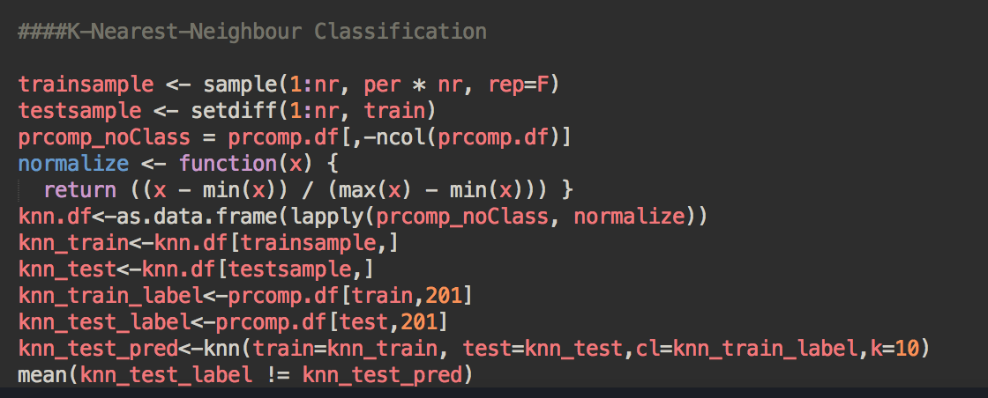
Code Snippet for k-Nearest Neighbor

Slide 16
Misclassification Error Rates
Support Vector Machine 12%
Random Forest 25%
K-Nearest Neighbor 60%

Slide 17
12%
Whoa! That’s close to 0% error!

Slide 18
Thanks!
Any questions?
Presentation template by SlidesCarnival

